Slide 1
Laplace Transform
Melissa Meagher
Meagan Pitluck
Nathan Cutler
Matt Abernethy
Thomas Noel
Scott Drotar

Slide 2
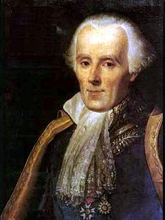
The French Newton
Pierre-Simon Laplace
Developed mathematics in astronomy, physics, and statistics
Began work in calculus which led to the Laplace Transform
Focused later on celestial mechanics
One of the first scientists to suggest the existence of black holes
Notes:
A French mathematician and astronomer from the late 1700’s. His early published work started with calculus and differential equations. He spent many of his later years developing ideas about the movements of planets and stability of the solar system in addition to working on probability theory and Bayesian inference. Some of the math he worked on included: the general theory of determinants, proof that every equation of an even degree must have at least one real quadratic factor, provided a solution to the linear partial differential equation of the second order, and solved many definite integrals.
He is one of only 72 people to have his name engraved on the Eiffel tower.

Slide 3

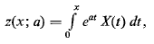

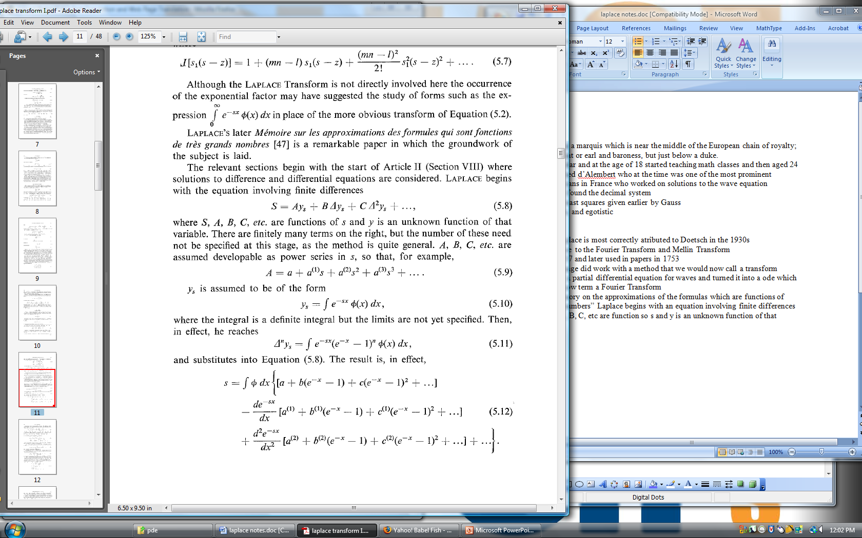
History of the Transform
Euler began looking at integrals as solutions to differential equations in the mid 1700’s:
Lagrange took this a step further while working on probability density functions and looked at forms of the following equation:
Finally, in 1785, Laplace began using a transformation to solve equations of finite differences which eventually lead to the current transform
Notes:
Laplace also recognized that Joseph Fourier's method of Fourier series for solving the diffusion equation could only apply to a limited region of space as the solutions were periodic. In 1809, Laplace applied his transform to find solutions that diffused indefinitely in space

Slide 4

Definition
The Laplace transform is a linear operator that switched a function f(t) to F(s).
Specifically:
where:
Go from time argument with real input to a complex angular frequency input which is complex.

Slide 5
Restrictions
There are two governing factors that determine whether Laplace transforms can be used:
  f(t) must be at least piecewise continuous for t ≥ 0
  |f(t)| ≤ Me^{γt} where M and γ are constants

Slide 6
Continuity
Since the general form of the Laplace transform is:
it makes sense that f(t) must be at least piecewise continuous for t ≥ 0.
If f(t) were very nasty, the integral would not be computable.

Slide 7
Boundedness
This criterion also follows directly from the general definition:
If f(t) is not bounded by Me^{γt} then the integral will not converge.

Slide 8






Laplace Transform Theory
General Theory
Example
Convergence

Slide 9
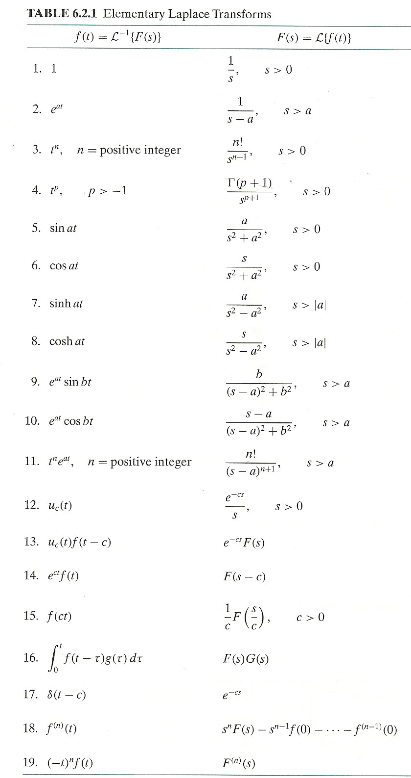

Laplace Transforms
Some Laplace Transforms
Wide variety of function can be transformed
Inverse Transform
Often requires partial fractions or other manipulation to find a form that is easy to apply the inverse

Slide 10





Laplace Transform for ODEs
Equation with initial conditions
Laplace transform is linear
Apply derivative formula
Rearrange
Take the inverse

Slide 11



Laplace Transform in PDEs
Laplace transform in two variables (always taken with respect to time variable, t):
Inverse laplace of a 2 dimensional PDE:
Can be used for any dimension PDE:
The Transform reduces dimension by “1”:
ODEs reduce to algebraic equations
PDEs reduce to either an ODE (if original equation dimension 2) or another PDE (if original equation dimension >2)

Slide 12
Consider the case where:
u_{x}+u_{t}=t with u(x,0)=0 and u(0,t)=t² and
Taking the Laplace of the initial equation leaves U_{x}+ U=1/s² (note that the partials with respect to “x” do not disappear) with boundary condition U(0,s)=2/s³
Solving this as an ODE of variable x, U(x,s)=c(s)e^{-x} + 1/s²
Plugging in B.C., 2/s³=c(s) + 1/s² so c(s)=2/s³ - 1/s²
U(x,s)=(2/s³ - 1/s²) e^{-x} + 1/s²
Now, we can use the inverse Laplace Transform with respect to s to find
u(x,t)=t²e^{-x} - te^{-x} + t

Slide 13
Example Solutions

Slide 14
Diffusion Equation
u_{t} = ku_{xx} in (0,l)
Initial Conditions:
u(0,t) = u(l,t) = 1, u(x,0) = 1 + sin(πx/l)
Using af(t) + bg(t) → aF(s) + bG(s)
and df/dt → sF(s) – f(0)
and noting that the partials with respect to x commute with the transforms with respect to t, the Laplace transform U(x,s) satisfies
sU(x,s) – u(x,0) = kU_{xx}(x,s)
With e^{at} → 1/(s-a) and a=0,
the boundary conditions become U(0,s) = U(l,s) = 1/s.
So we have an ODE in the variable x together with some boundary conditions. The solution is then:
U(x,s) = 1/s + (1/(s+kπ²/l²))sin(πx/l)
Therefore, when we invert the transform, using the Laplace table:
u(x,t) = 1 + e^{-kπ2t/l2}sin(πx/l)

Slide 15
Wave Equation
u_{tt} = c²u_{xx} in 0 < x < ∞
Initial Conditions:
u(0,t) = f(t), u(x,0) = u_{t}(x,0) = 0
For x → ∞, we assume that u(x,t) → 0. Because the initial conditions vanish, the Laplace transform satisfies
s²U = c²U_{xx}
U(0,s) = F(s)
Solving this ODE, we get
U(x,s) = a(s)e^{-sx/c} + b(s)e^{sx/c}
Where a(s) and b(s) are to be determined.
From the assumed property of u, we expect that U(x,s) → 0 as x → ∞.
Therefore, b(s) = 0. Hence, U(x,s) = F(s) e^{-sx/c}. Now we use
H(t-b)f(t-b) → e^{-bs}F(s)
To get
u(x,t) = H(t – x/c)f(t – x/c).

Slide 16




Real-Life Applications
Semiconductor mobility
Call completion in wireless networks
Vehicle vibrations on compressed rails
Behavior of magnetic and electric fields above the atmosphere

Slide 17
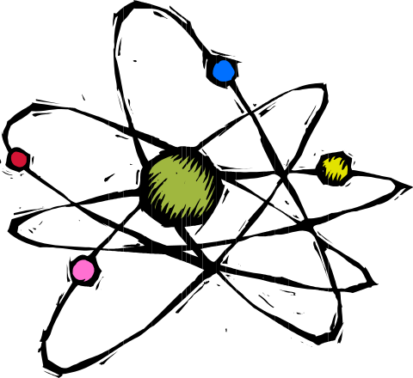
Ex. Semiconductor Mobility
Motivation
  semiconductors are commonly made with superlattices having layers of differing compositions
  need to determine properties of carriers in each layer
    concentration of electrons and holes
    mobility of electrons and holes
  conductivity tensor can be related to Laplace transform of electron and hole densities

Slide 18

Notation
R = ratio of induced electric field to the product of the current density and the applied magnetic field
ρ = electrical resistance
H = magnetic field
J = current density
E = applied electric field
n = concentration of electrons
u = mobility

Slide 19
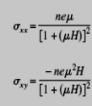


Equation Manipulation
and

Slide 20
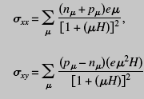
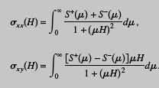
Assuming a continuous mobility distribution and that ,
, it follows:

Slide 21
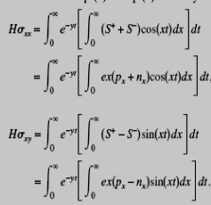
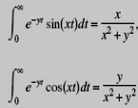
Applying the Laplace Transform

Slide 22
Source
Johnson, William B. Transform method for semiconductor mobility, Journal of Applied Physics 99 (2006).

